Slide 1
Online training on Bioclimatic Architecture – Principles and Best Practices
09.05.2022-09.06.2022
REPORT

Slide 2
Content
Program overview
1.1 Program description
1.2 Program partners
1.3 Program Agenda
1.4 Highlighted number
1.5 Program responses
2. Program results
2.1. Communication results
2.2. Zoom
2.3. Google classroom
2.4. Participant responses
2.5. Presented projects
3. References

Slide 3
1. PROGRAM OVERVIEW

Slide 4
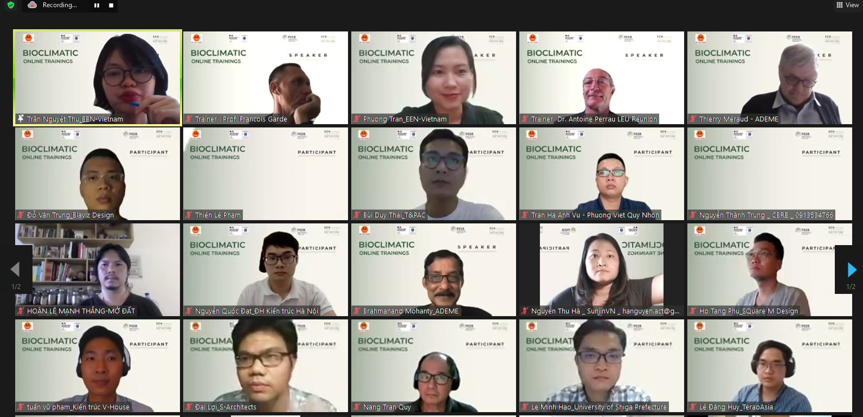
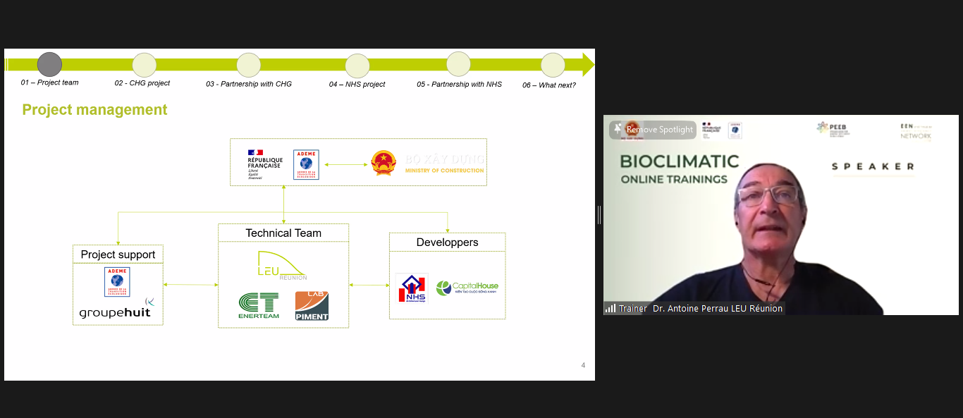
9
Event Partners
1. Program overview
1.1. Program description
Online training on Bioclimatic Architecture – Principles and Best Practices is a part of the operation Low-carbon buildings and sustainable city in Vietnam which was jointly organized by the Department of Science, Technology and Environment (DSTE) of the Ministry of Construction (MOC) in Vietnam and the French Agency for Ecological Transition (ADEME). The objective of this training is to provide Vietnamese actors with a bioclimatic design method to apply in new construction projects to lower operating energy and improve thermal comfort.
Format: Online via Zoom Meeting & Google classroom
Time: 9 May to 9 June 2022
Duration: 5 training sessions and 2 workshops
Beneficiaries: Professionals from the building sector in Vietnam (developers, architects, engineers, building sustainability practitioners)
Language: Vietnamese and French

Slide 5
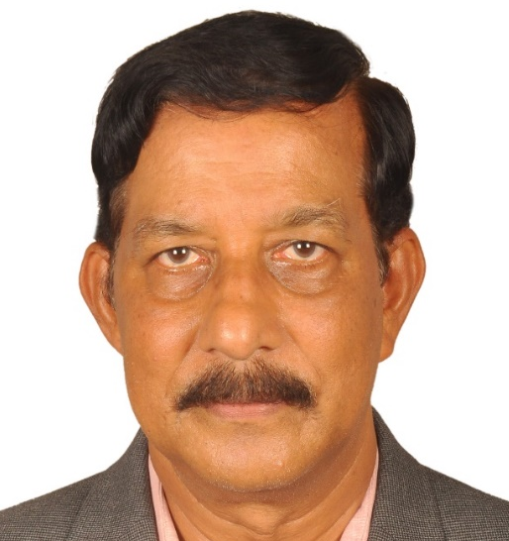
1. Programme overview
1.2. Đối tác chương trình
French Agency for Ecological Transition (ADEME)
Ministry of Construction (MOC)
The Programme for Energy Efficiency in Buildings (PEEB)
Vietnam Energy Efficiency Network (EEN-Vietnam)
Trainer
Facilitator
Prof. François Garde, Director and Professor at the ESIROI School of Engineering, University of La Réunion.
Dr. Brahmanand Mohanty, Asian regional advisor, Agency for Ecological Transition (ADEME).
Trainer
Facilitator
Prof. Dr. Antoine Perrau, manager of LAB Réunion, and co-manager of urban, landscape and QEB design office, LEU Réunion.
Arch. Nguyen Ngoc Tu, consulting expert on energy efficient buildings.

Slide 6
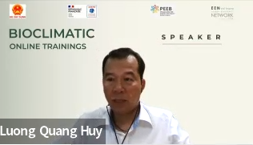
1. Programme overview
1.2. Programme Partners
Guest speakers
Mr. Philippe Masset,
Director of Agency for Ecological Transformation (ADEME)
Mr. Thierry Meraud,
Head of Bilateral and Multilateral Cooperation of ADEME
Ms. Vu Thi Kim Thoa,
Senior program officer,
GIZ Vietnam
Assoc. Prof. Dr. Vu Ngoc Anh,
representative of the Ministry of Construction of Vietnam
Ms. Nguyen Thi Thanh An,
Head of Climate and Energy Department,
French Development Agency in Vietnam AFD
Dr. Luong Quang Huy, representative of Vietnam's Ministry of Natural Resources and Environment
Mr. Nguyen Hai Dang,
Architectural planning manager Capital House Group
Assoc. Prof. Dr. Le Nguyen Minh, Consultant, NHS energy-saving social housing project

Slide 7
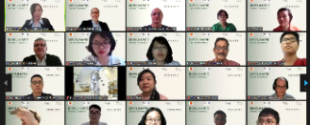
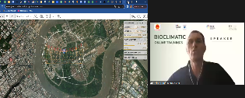
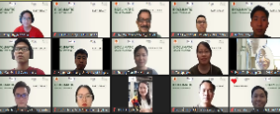
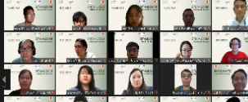
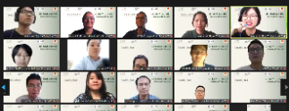
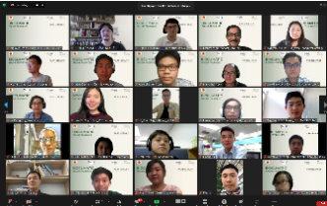
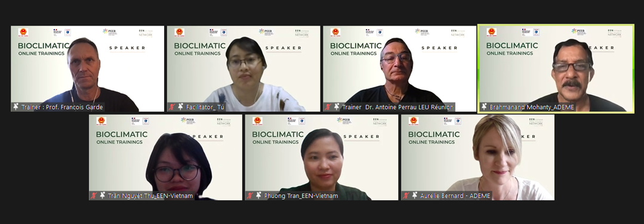
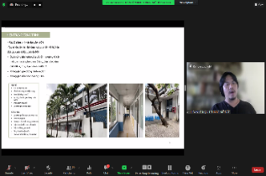
1. Programme overview
1.3. Program Agenda
Introductory session | Session 1 | Session 2 | Session 3
9th May 2022 Why a training on bioclimatic design and sustainable city in Vietnam? | 11st May 2022 Climate Analysis | 12th May 2022 Principles of natural ventilation and the urban approach | 18th May 2022 Climate analysis and notion of comfort in tropical climate
Session 4 | Session 5 | Final Workshop
19th May 2022 Thermal and Natural Ventilation Design in a Tropical humid Environment | 25th May 2022 Importance of vegetation Mixed Mode Buildings and Case Studies | 9th June 2022 Thermal and natural ventilation design in a humid tropical environment

Slide 8
1. Programme overview
1.4. Program Responses
“I would like to convey my sincere appreciation to the VSSE team – who have accompanied with us in this frame of collaboration as the organization team of the training”
- Mr. Thierry Meraud, Head of Bilateral and Multilateral Cooperation of ADEME
“The program is fantastic, and the professional content is outstanding. Excellent instructors, and the entire EEN team is quite professional! Thank you for everything!”
- Nguyen Truong Giang, Phuc Khang Construction and Investment Corporation
“At ADEME, we collaborate with a number of renowned professionals in this sector. We'll keep an eye on you to see if there's anything we can do to help. Furthermore, we value VSSE's efforts and look forward to working with them again in the future”
- Ms. Aurélie Bernard – ADEME
“Thank you very much for your training! The information and knowledge given would at the same time be new and very useful for me while I am still a student. I hope to have the chance to see you again in the very near future”
- Dao Thanh Tam, Student of University of Architecture Ho Chi Minh City
“I'm delighted that our educated approach is appropriate for you. I'm pleased to share what I know about our project with you. In the future, I hope to have the opportunity to work with you”
- Prof. François Garde, Trainer

Slide 9
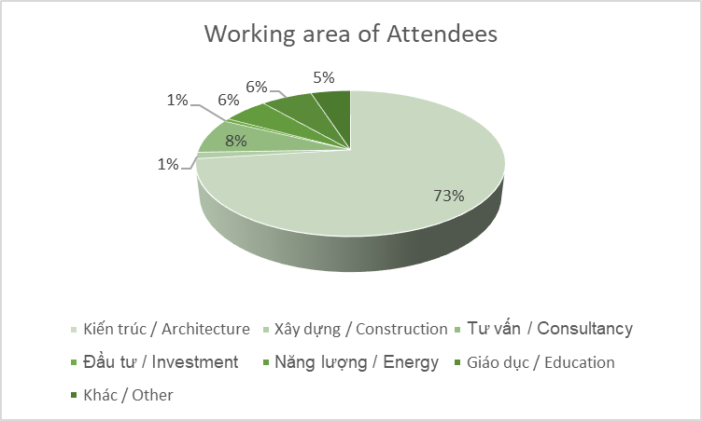
1. Programme overview
1.5. Highlighted Number
Participants
293
798
165
Program registrants
Online zoom participation
Students on google classroom
Interactions
15.141
93
Media reach
Questions & comments
Feedbacks
4.57/5
4.63/5
100%
Level of satisfaction with program organization
Level of satisfaction with program content
Participants want to join the next training program

Slide 10
2. PROGRAMME RESULTS

Slide 11
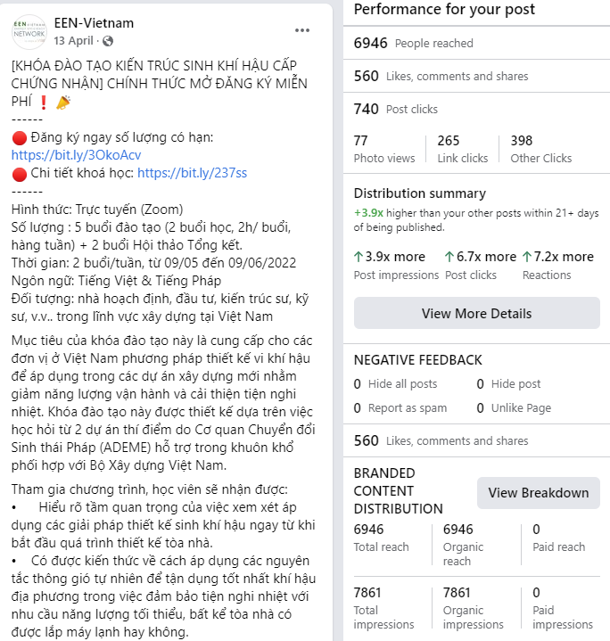
2. Program results
2.1. Communication results
15.141
3,441
212
Media reach
interactions
likes
71
62
shares
Participant request
before event
10
promotion posts on 03 channels

Slide 12
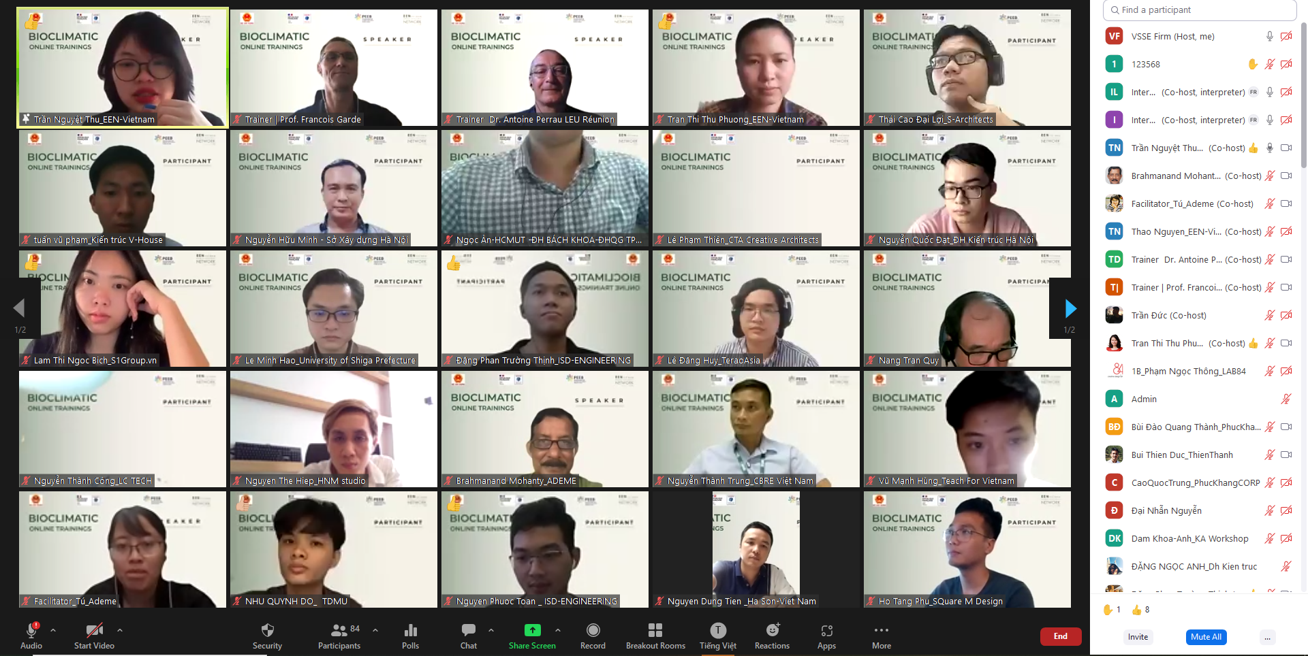
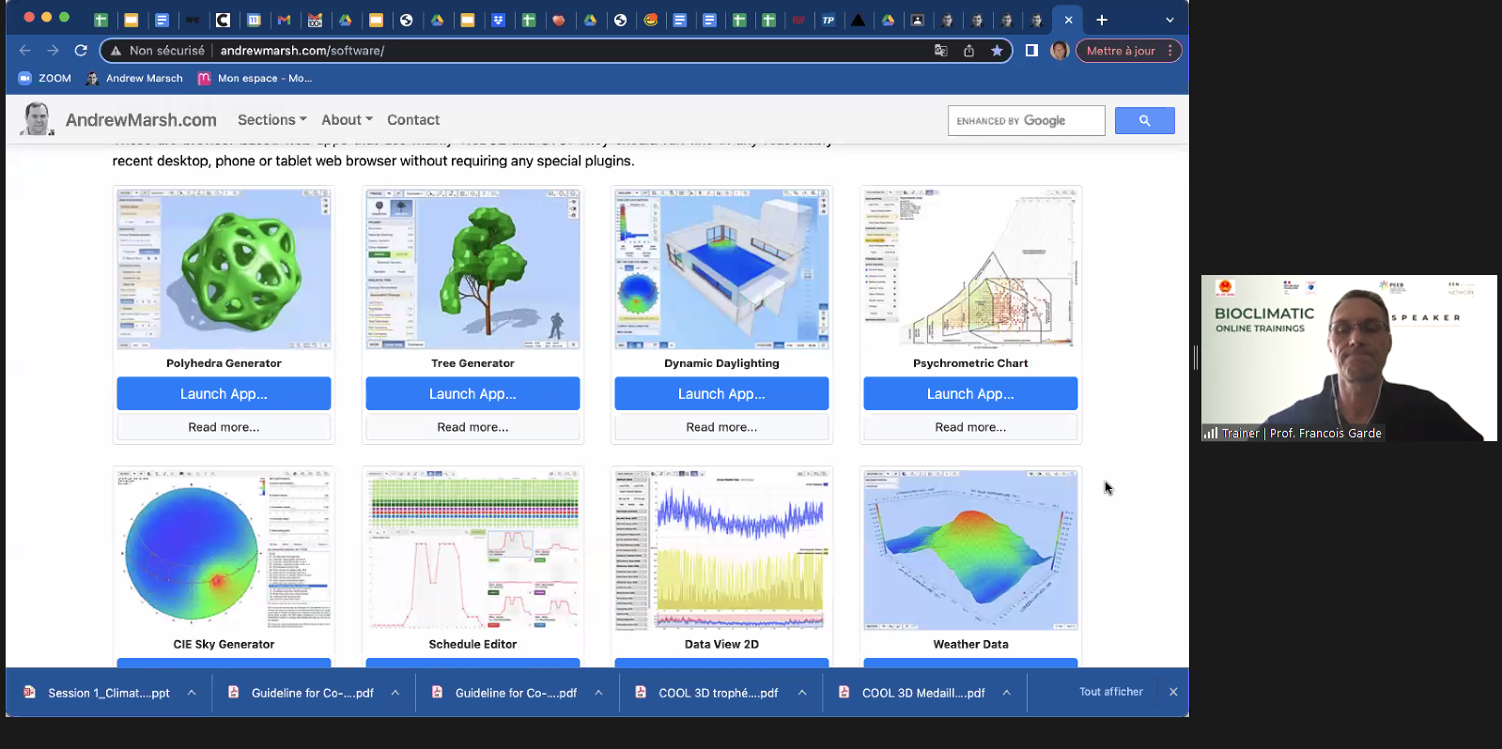
2. Program results
2.2 Zoom | Online learning platform
141
798
Trainees
participations
77
70
Questions and comments on Zoom
Interactive Quizzes
05
02
04
Training sessions
Workshops
experts

Slide 13
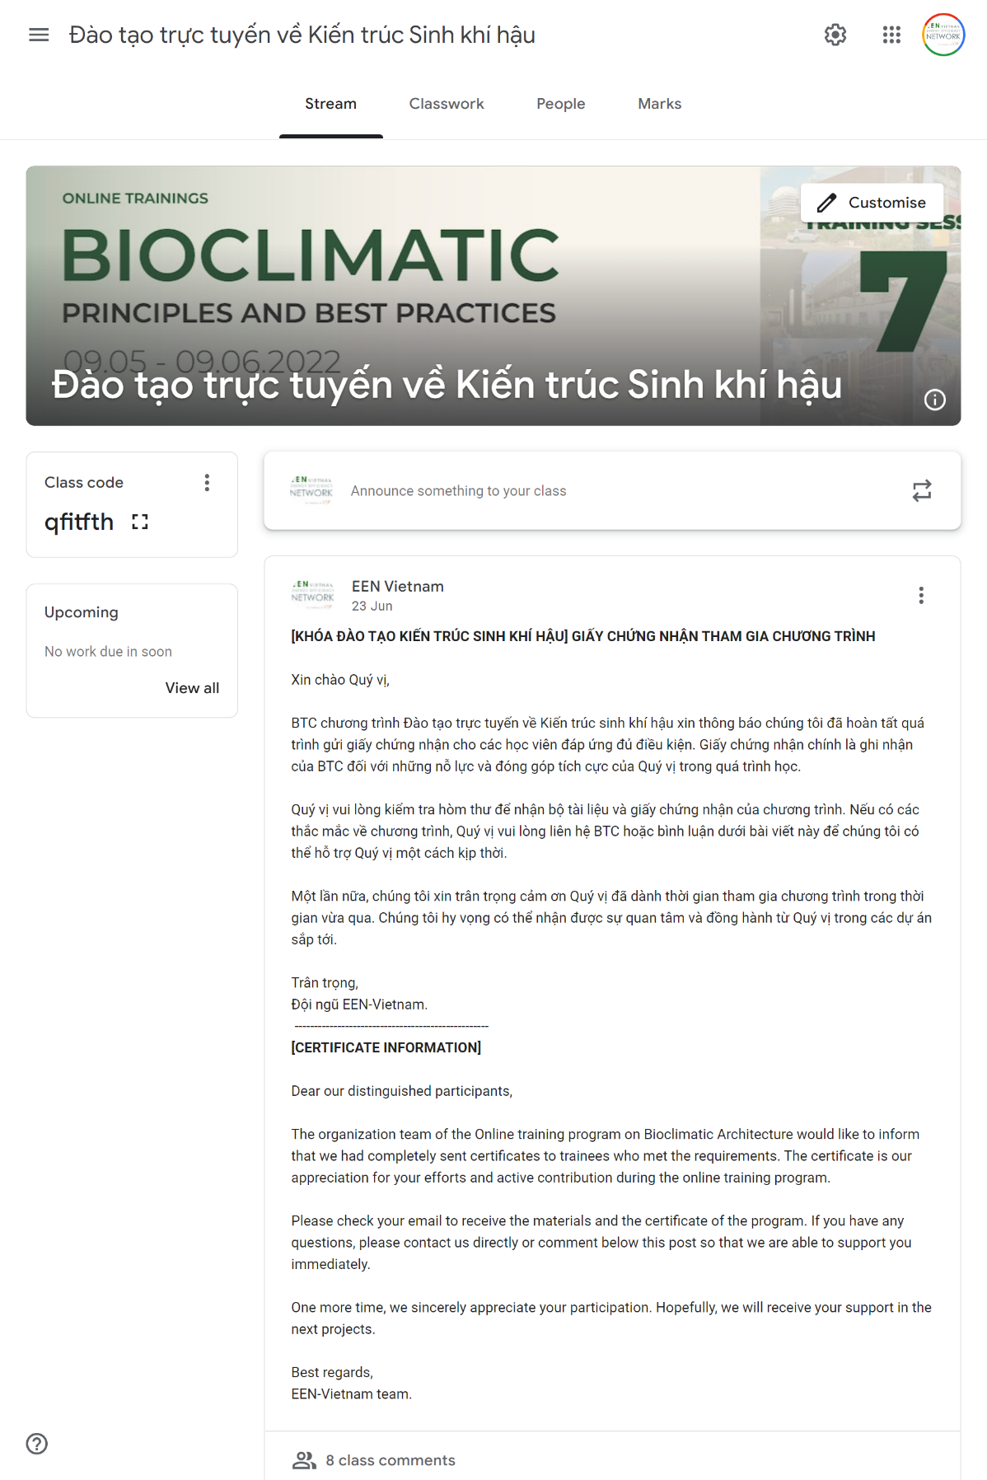
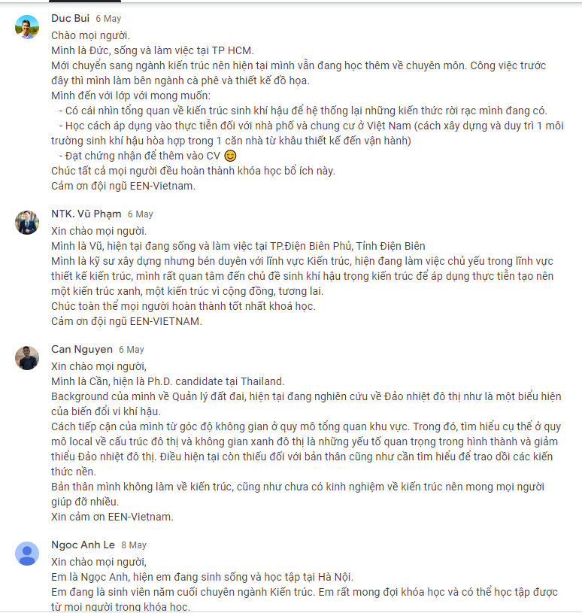
2. Program results
2.3. Google classroom | After-class information exchange platform
165
41
13
Participants
Recorded questions & comments
Exchange posts
18
10
Materials shared
Sharings from experts

Slide 14
2. Program results
2.4. Participant responses
Level of satisfaction on program content
4.69/5
4.80/5
4.55/5
Training content
Trainers
In-class activities
Level of satisfaction on program organization
4.70/5
4.56/5
4.56
4.44/5
Information about the program
Academic support
Technical support
After-class support
“Thanks organizers. This training provided a host of amazing knowledge” - Bui Duy Thai, participant
“Thanks organization team and guests. The training is very helpful. I hope that there would be more programs like this in the future.” - Phuong Thi Thanh Loan, participant
“The knowledge given in this online training is practical” - Pham Tuan Vu (V- House), participant

Slide 15
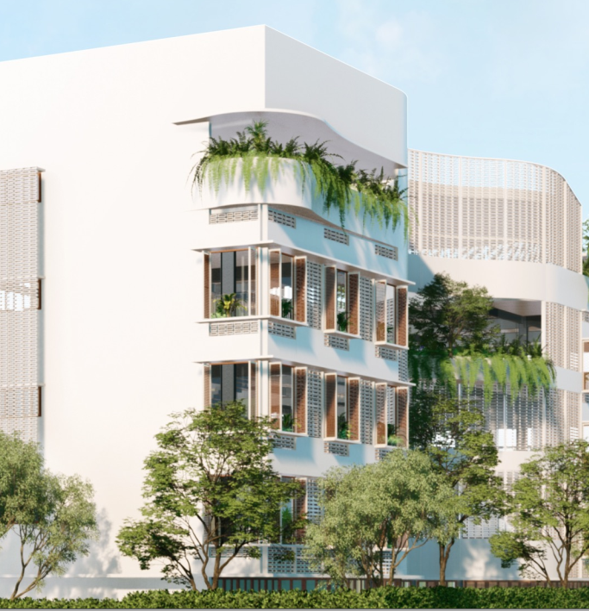
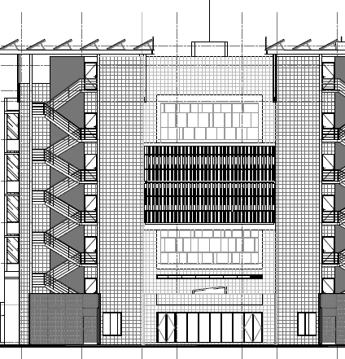
2. Program results
2.4. Presented projects
Project presented by participants in the final workshop
Scavi head office project
Hoàng Lê Mạnh Thắng, Architect, Ateliers Mở Đất
One UN house in Hanoi
Trần Qúy Năng, Director,
Nang Tran Green your building,
Kim Lien collective residence
Nguyễn Mạnh Tuấn, Architect,
Kecho collective

Slide 16
3. References
About ADEME
https://www.ademe.fr/en/frontpage/
About EEN-Vietnam
https://www.facebook.com/energyefficiencynetwork/
About program trainers
https://bom.so/oyVozt
Training program agenda
https://bom.so/3IsJAY
Program event page
https://fb.me/e/2BMufbe9h
Recap Video
https://youtu.be/ApxjFjpFpPY
Program Website
https://vsse.vn/en/online-training-on-bioclimatic-architecture-principles-and-best-practices/

Slide 17
A Special Thanks to Our Partners & All
Chung tay Xây dựng Tương lai Bền vững
Building Sustainable Future ... together !

Slide 18
Thank you very much
Contact
EEN-Vietnam
Vietnam Energy Efficiency Network
Email: info@vsse.vn
Office + 84 24 66 55 3445
EEN-Vietnam
Notes:
Thêm LinkedIn của EEN

